Slide 1
Pivot
Pivot

Slide 2
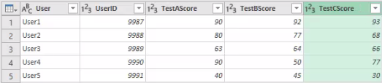
Pivot
Note: This Lab uses the Store.xlsx file located in the resources\Advanced Transformations folder
Select the Unpivot table and load the data at the editor level
Select the three columns Test A|B|C Score and click Unpivot on the Transform tab
Now load the Pivot table from the source file

Slide 3
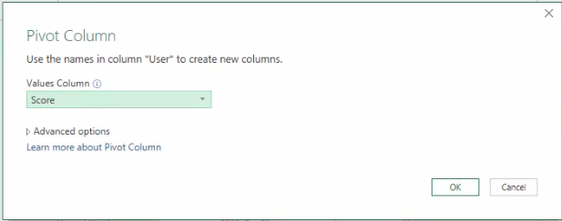
Pivot
Select the Test column and select the Score values column and click OK

Slide 4
Thank you
Thank you

